Slide 1
Population Regression
Group 6
Members:
CUI ZHENGKANG, FENG WENDI, WANG YUTONG
SUN CHENYA, ZHOU YIDUAN, ZHANG ZHOUHAO, XIE HAO

Slide 2
Contents
01
Problem Description
02
Experimental Setup
03
Results Analysis
04
Reflection

Slide 3

Problem Description
Population forecasting
One of the most important social issues for every country
Understand the size of the population and the structure of society
Better distribution of social resource,
Formulation of more reasonable strategies

Slide 4

Problem Description
Population numbers of Singapore and China
(1960 – 2022)
Linear regression $→$ build an estimator of the total population
Forecast
The data of 2019 and earlier as training data
2020 and later as test data
Visualize the result,
Analyzing the errors,
Project the population size for 2023，2030，2050

Slide 5
Derivation

Slide 6
Ideas
1、General linear regression
2、Polynomial regression
3、Heat map

Slide 7
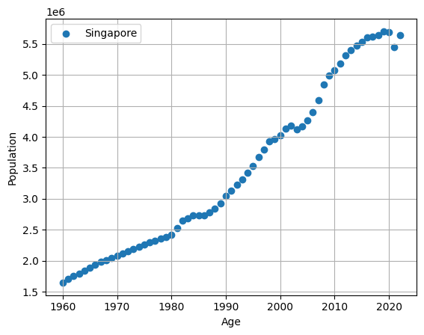
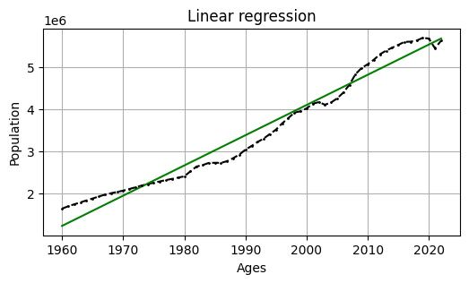
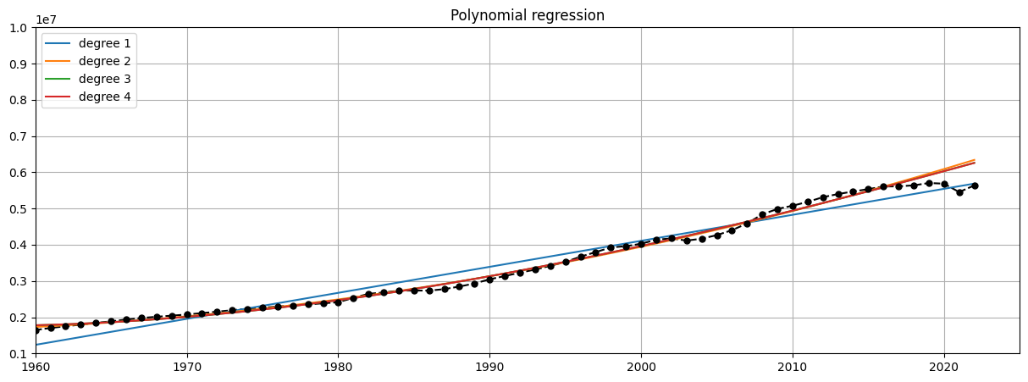

Results
Prediction:
2023 : 5,758,855
2030 : 6,261,276
2050 : 7,696,764
MSE of linear regression is close to one degree ridge regression，much less than polynomial regression’s MSE.

Slide 8
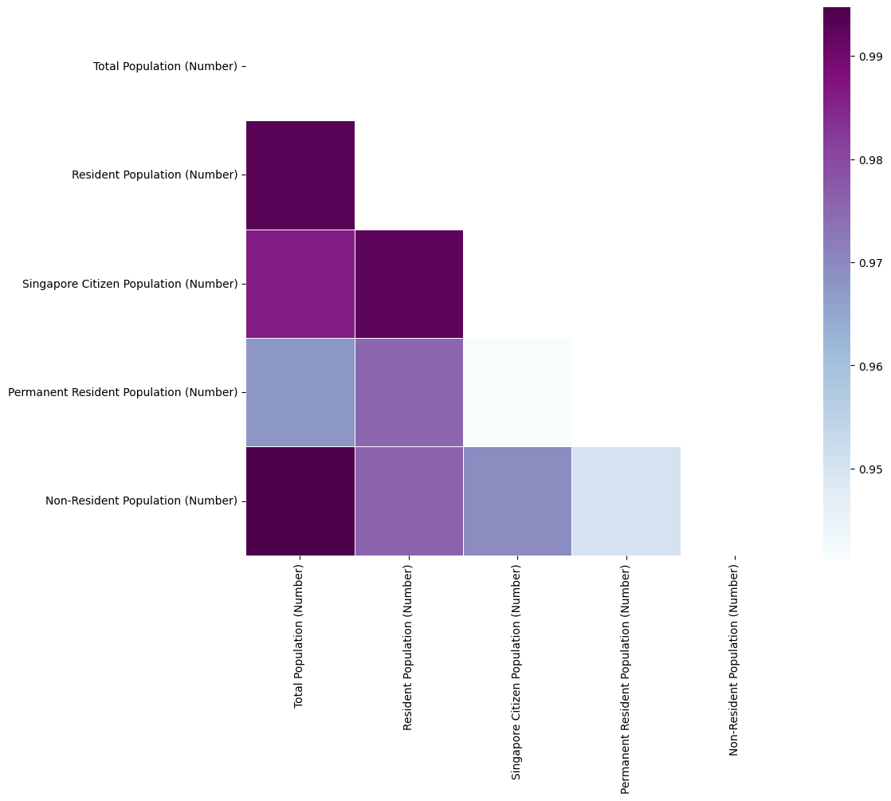
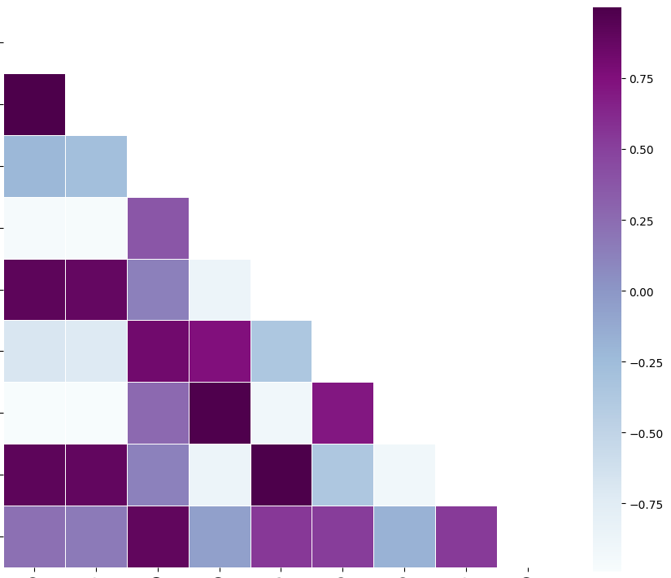
Extra Analysis

Slide 9
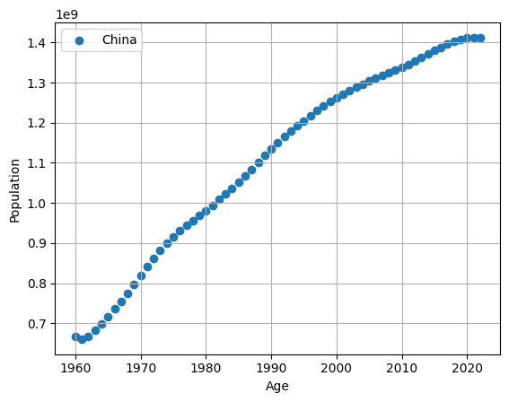
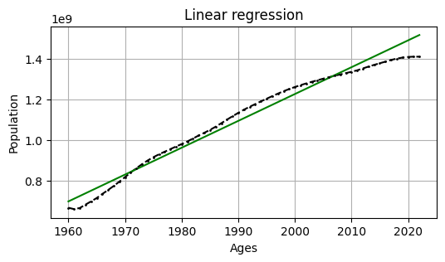
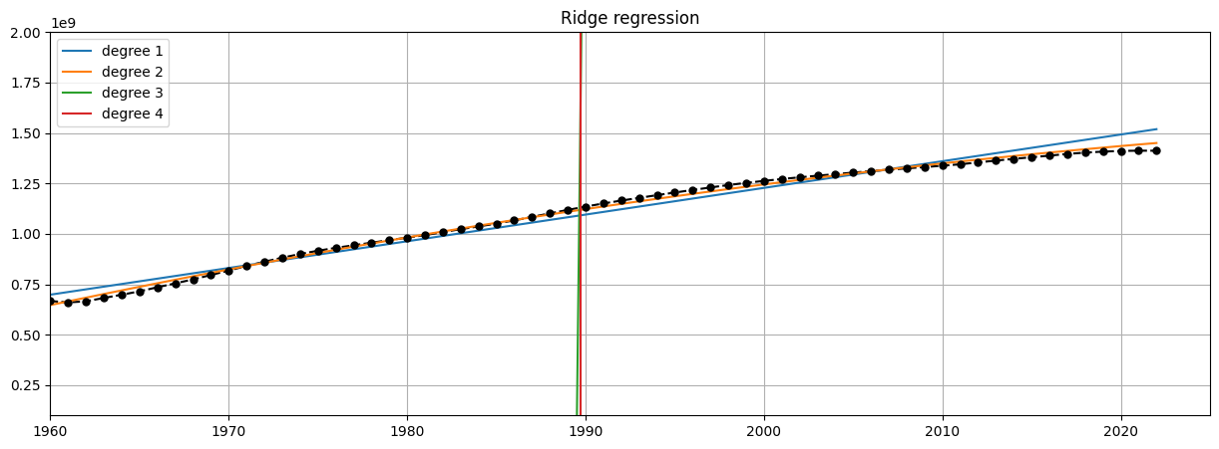
Linear Regression of China Population Analysis
Prediction:
2023 : 1,532,468,499
2030 : 1,625,141,655
2050 : 1,889,922,103
When the degree of polynomial regression is four, its MSE is the smallest, but it is the same order of magnitude as the MSE of quadratic ridge regression, but the quadratic coefficient of the latter is 1-2 orders of magnitude smaller than the former, so we think that ridge regression is more for fit.

Slide 10
Linear Regression Is Not Enough

Slide 11
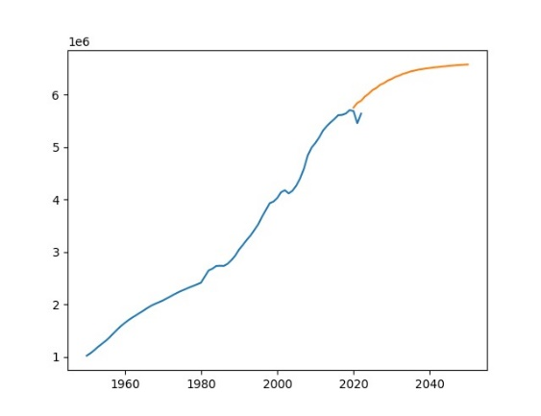
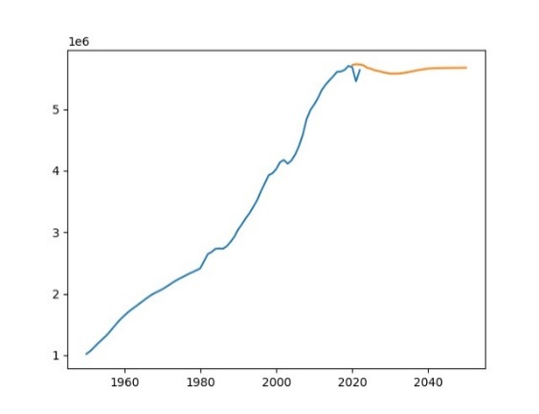
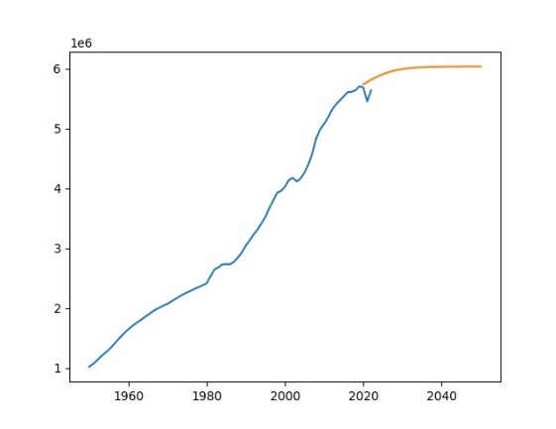
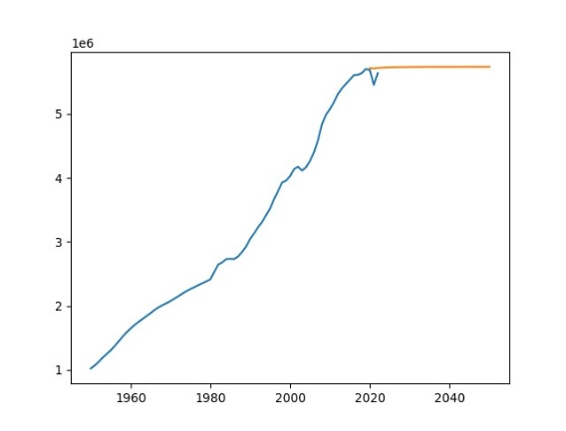
RNNs’Dilemma
Prediction
Growth stopped：
No enough data
Gradients vanished
RNN is a little bit better
Less layer, Better
Error accumulation
Orin data
1 Layer RNN
2 Layers RNN
29-dimensional features are used.
1 Layer LSTM
2 Layers LSTM

Slide 12
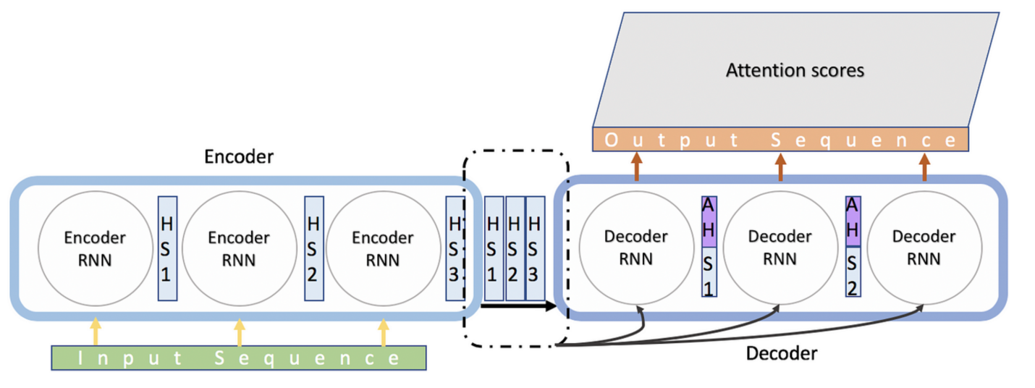
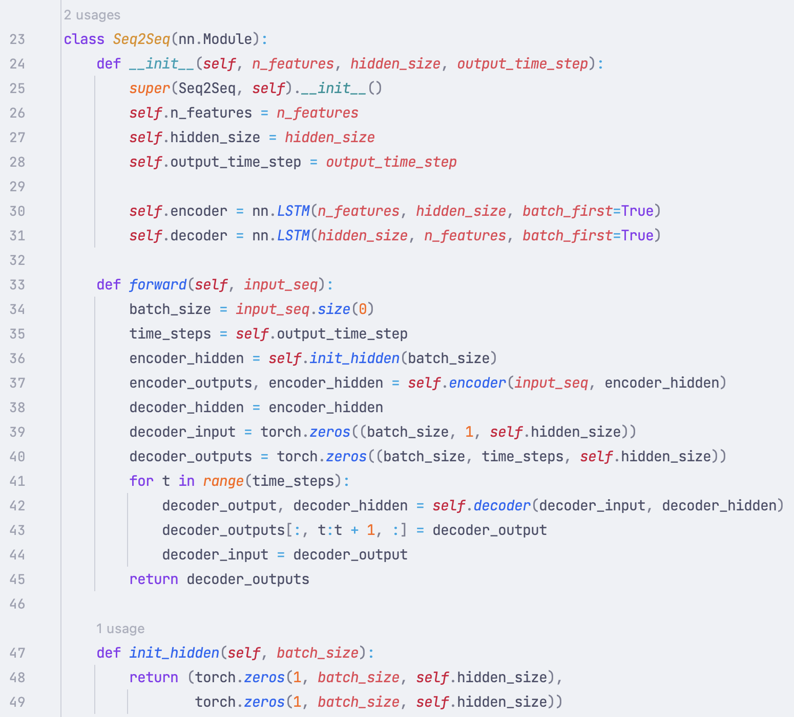
Breakthrough: Seq2Seq
We constructed it using pytorch!
More powerful on seq prediction task
No error accumulation

Slide 13
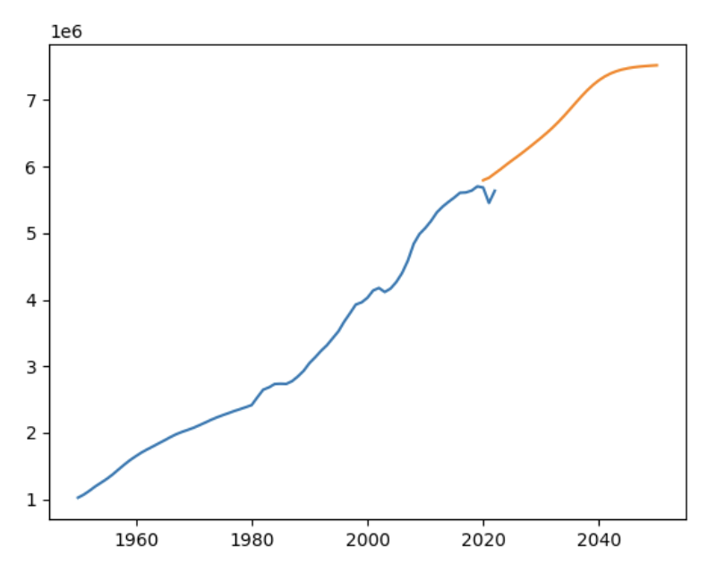
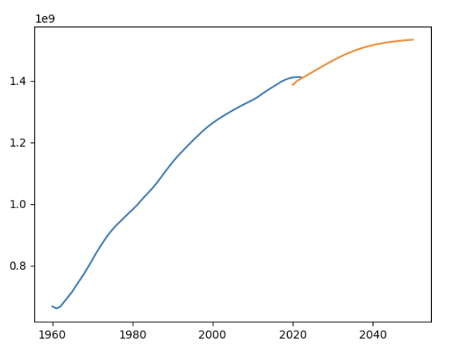
Amazing Results
Prediction
Orin data
Singapore
Converged to 7.5 million
China
Converged to 1.5 billion
Reasonable

Slide 14
Reflection
Professional knowledge
01
Overview of machine learning
Basic code
02
03
Learning ability
Logical structure
Learning route
Different backgrounds
Open up mind
Collaboration

Slide 15
Thank you for watching.

